Slide 1

Emerging Technologies
Session #13: Watson Developer Cloud
IBM Bluemix
The Digital Innovation Platform
Sylvain-Roch WILBERT
s_wilbert@fr.ibm.com
Université Paris - Dauphine

Slide 2
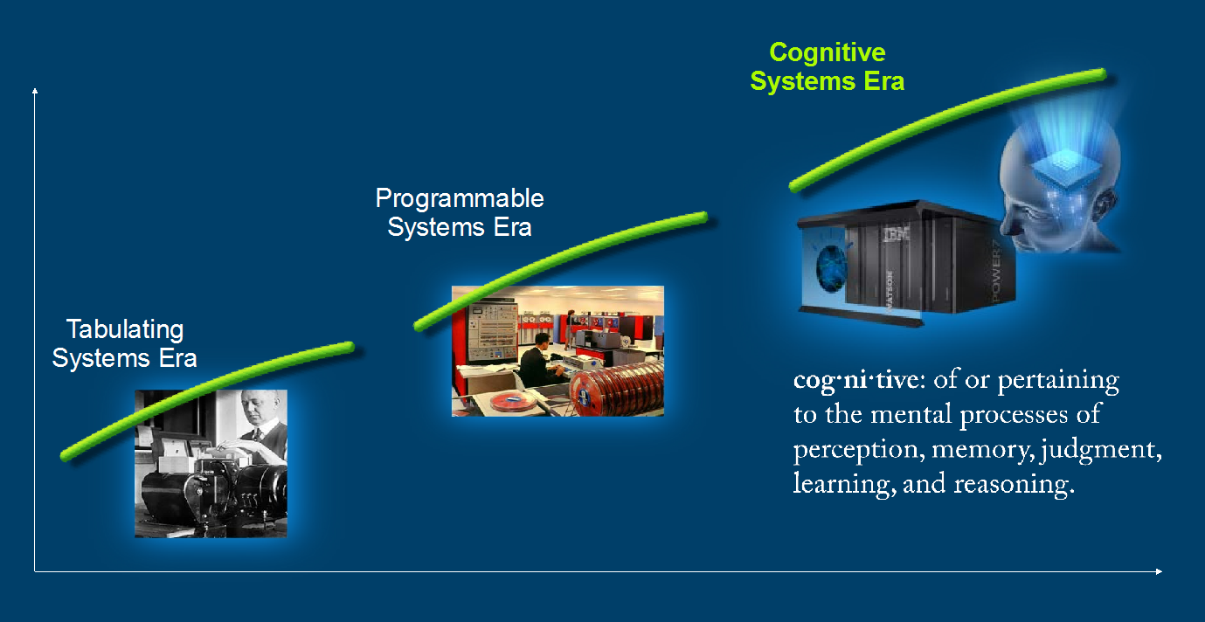
IBM WATSON in a nutshell The cognitive era
http://www.youtube.com/watch?v=Y_cqBP08yuA

Slide 3
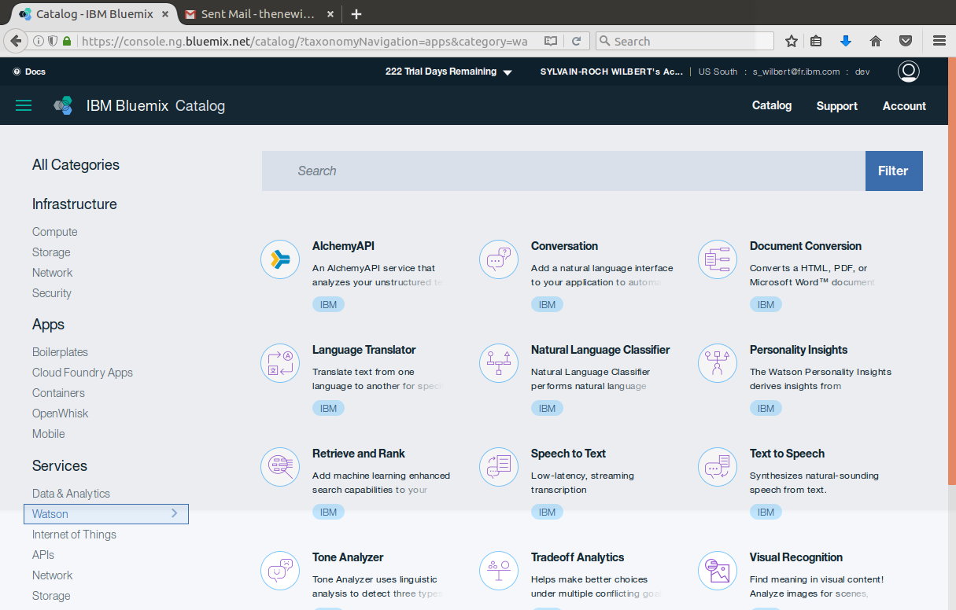
IBM WATSON in a nutshell the Watson Developer Cloud

Slide 4
Exercize– My application Enabling cognitive computing
Same overall principle
Pick and chose in the catalog the required service
Retrieve the credentials for the service in the environment variables
Consult the documentation to understand the integration in a node.js application
Adjust locally your application in ATOM, or live in Bluemix
(push) Build and Deploy your changes

